Slide 1
SECURING
CRYPTOGRAPHIC PROTOCOLS-2

Slide 2
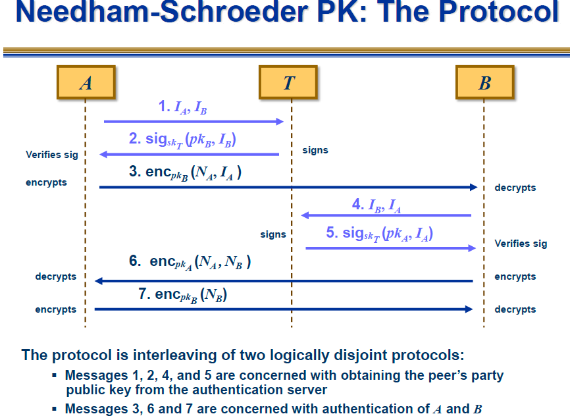
Securing Cryptographic protocols

Slide 3
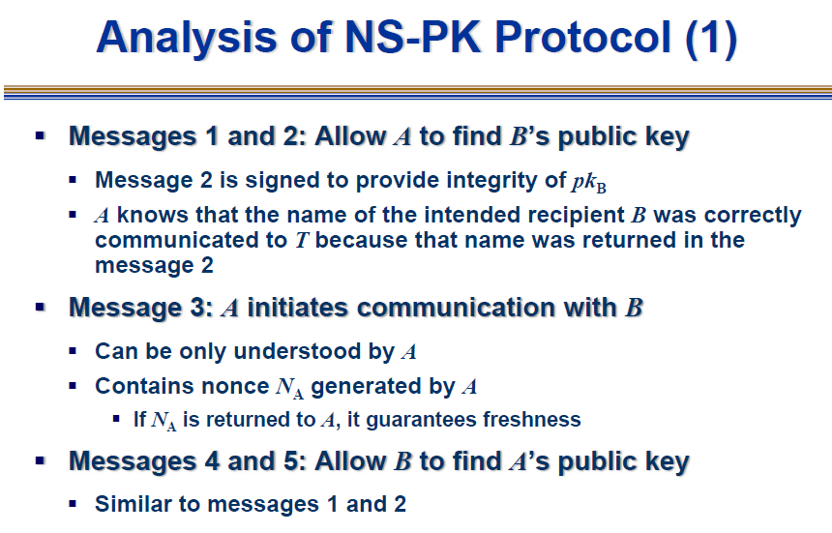
Securing Cryptographic protocols

Slide 4
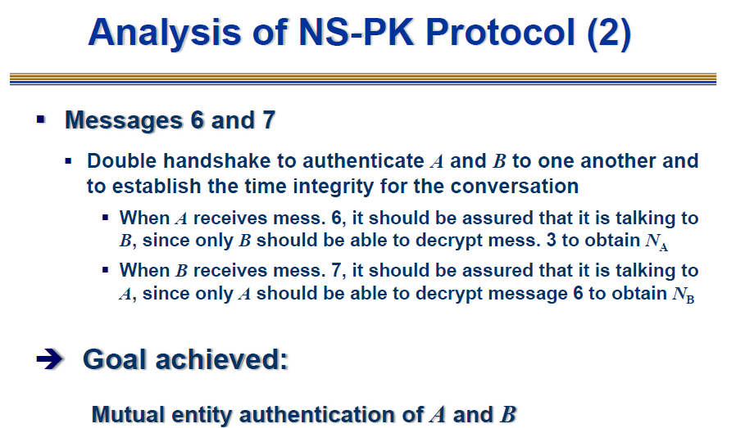
Securing Cryptographic protocols

Slide 5
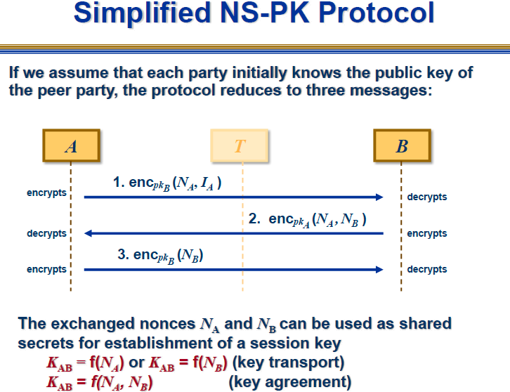
Securing Cryptographic protocols

Slide 6
Vulnerabilities of NS-PK Protocol
This protocol provides no guarantee that the public keys obtained by the client principals are current (Denning and Sacco)
This problem can be overcome in various ways for example, by including timestamps in the key deliveries.
We can assume that the client’s public keys that are obtained from Trent are current and good
In 1995, almost 20 years after the NS-PK protocol was published, Lowe showed that the protocol has some vulnerabilities
  B cannot be sure that the final message came from A
  The attack on the protocol allows an adversary Adv to impersonate a party A and to set up a false session with B
  The attack involves two simultaneous runs of the protocol
Securing Cryptographic protocols

Slide 7
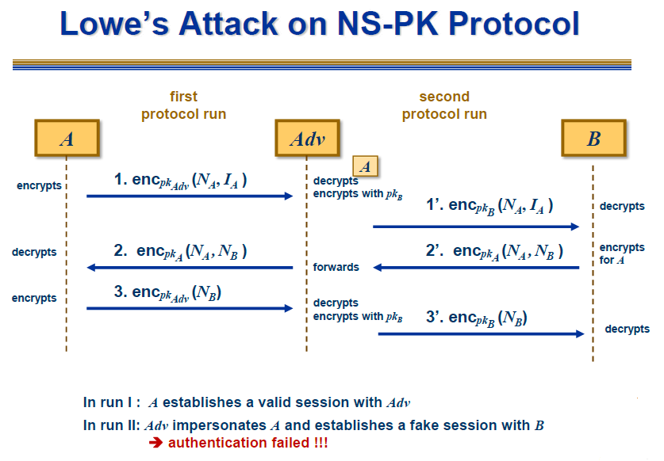
Securing Cryptographic protocols

Slide 8
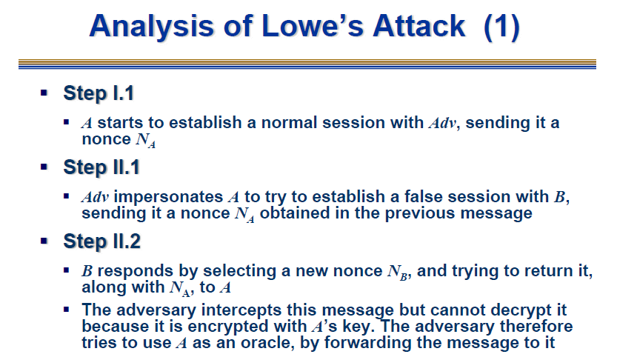
Securing Cryptographic protocols

Slide 9
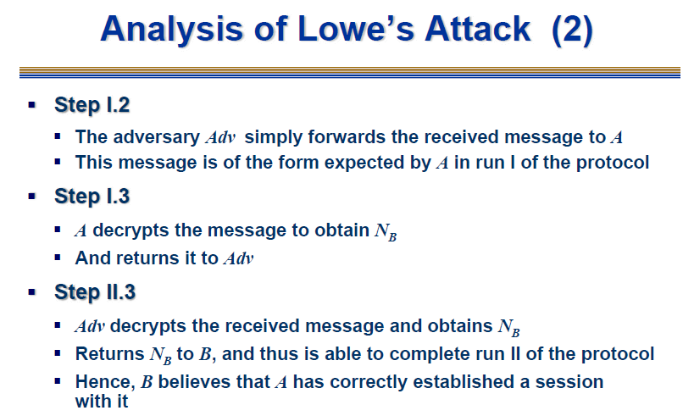
The adversary
Securing Cryptographic protocols

Slide 10
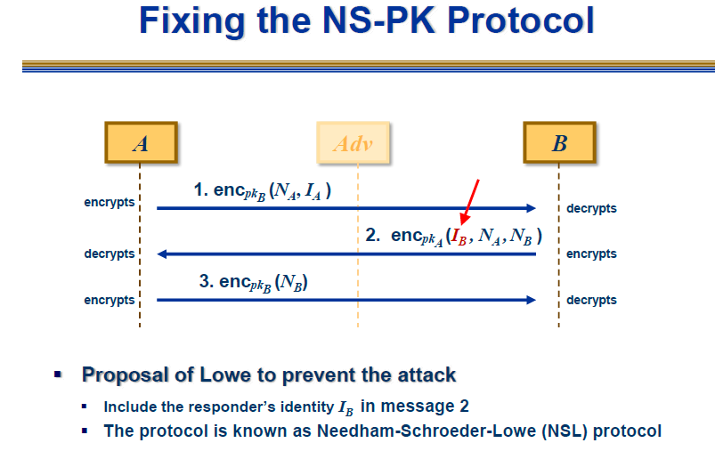
Securing Cryptographic protocols

